Slide 1
The Great Gatsby: Chapter 6
Samantha G. Herrera
IB English IV SL

Slide 2
Chapter Summary
Video
Key Points of the Chapter:
A reporter visits Gatsby’s house to interview him
Carraway learns of Jay Gatsby’s past
James Gatz’s meets Dan Cody
The story of Gatsby and Dan Cody is revealed
Tom becomes suspicious of Gatsby
Tom and Daisy go to one of Gatsby’s infamous parties
Gatsby wants to recreate the past
https://www.youtube.com/watch?time_continue=190&v=1JK713whbkE&feature=emb_logo

Slide 3
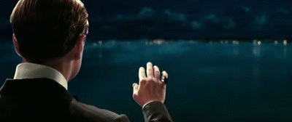
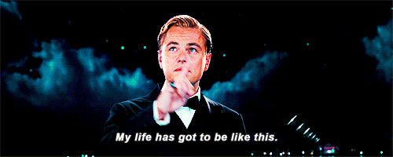
Chapter Analysis
The obtainment of a prestigious social status is consistently brought up in this chapter. Through the unveiling of Jay Gatsby’s past as James Gatz, his obsession and love with Daisy Buchanan and wealth, Tom Buchanan’s insincere invitation to Gatsby, and Tom’s negativity toward people from “New Money”. Gatsby’s past social status motivates him to an obsessed desire for power and wealth. Furthermore, the presentation of Dan Cody shows what Gatsby envisioned himself to be.
Gatsby’s desperation to repeat the past showcase the confusion within himself to comprehend that he lost Daisy five years ago and that he can’t get everything he wants. Also, the moment where Gatsby insists that he can fix everything as it was before, foreshadows his downfall through his stubbornness and obsession in winning Daisy.

Slide 4
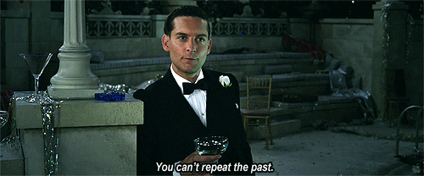
Tone and Mood
Tone
Sympathetic
Longing
Prejudice
Mood
Triumphant
Desperate

Slide 5
Theme
Social Class
Gatsby’s past showcases his trouble with social class and his desire to be a part of a more prestigious background. This can be shown through his invention of going to Oxford and hiding his reality from Daisy. Secondly, Tom’s negative outlook on “New Money” and the clear difference that he implies between people from old wealth to people from “New Money”.
The American Dream
The American Dream is showcased by Gatsby’s ability to earn wealth; this was emphasized by revealing Gatsby’s past. However, the failure of this dream can also be seen by the implication from Tom Buchanan that money is earned through the most corrupt ways.

Slide 6
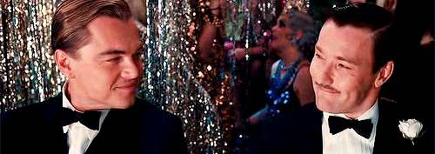
Purpose
The purpose of Chapter 6 is to further develop Gatsby’s character by revealing his past and how he came to wealth. However, the chapter is also meant to show that despite Gatsby’s forces to have prestige and wealth, he will never have class as shown through his interaction with Tom Buchanan and Mr. Sloane. There is a difference between New Money and Old Money, and it can be shown through Gatsby’s character and Tom’s character, both have different morals and ideals. Additionally, the purpose of this chapter is to show Gatsby’s desperation for Daisy and his obsession with her, rather than love.

Slide 7
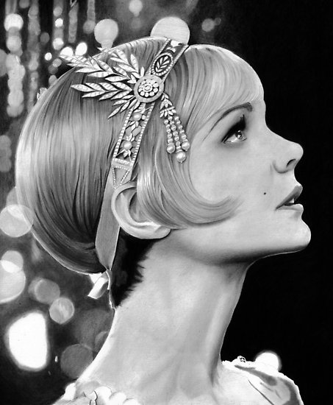
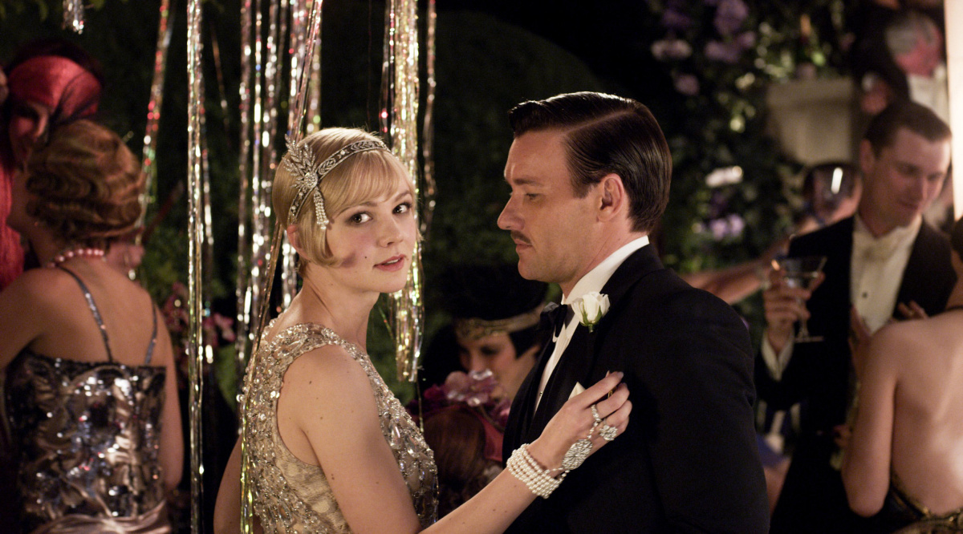
Symbolism
Dan Cody’s Yacht
This yacht represents the glamorous and wealthy life that Gatsby entered, when he met Dan Cody. Additionally, the yacht symbolizes the moment and shift in time when James Gats became Jay Gatsby.
“Little Gold Pencil”
Daisy’s little gold pencil that she gives Tom represents her social status through its bold color. By giving it to Tom she is demonstrating her sophistication and wealthy position.
The White Plum Tree & Daisy’s White Face
The tree and Daisy’s white face represent the innocence and purity that Gatsby blindly sees in Daisy. Furthermore, the white plum tree is described to have a woman and man under it with proximity, which breaks the veil of innocence and purity. Additionally, the tree can represent the elite society due to its deceiving façade.

Slide 8
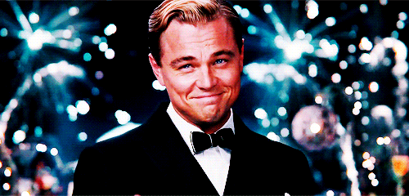
Thank you for your time.

