Slide 1
Chapter 7
Juan Lopez

Slide 2
Summary
On the hottest day of the summer, Nick takes the train to East Egg for lunch at the house of Tom and Daisy. He finds Gatsby and Jordan Baker there as well. When the nurse brings in Daisy’s baby girl, Gatsby is stunned and can hardly believe that the child is real. For her part, Daisy seems almost uninterested in her child. During the awkward afternoon, Gatsby and Daisy cannot hide their love for one another. Complaining of her boredom, Daisy asks Gatsby if he wants to go into the city. Gatsby stares at her passionately, and Tom becomes certain of their feelings for each other.

Slide 3
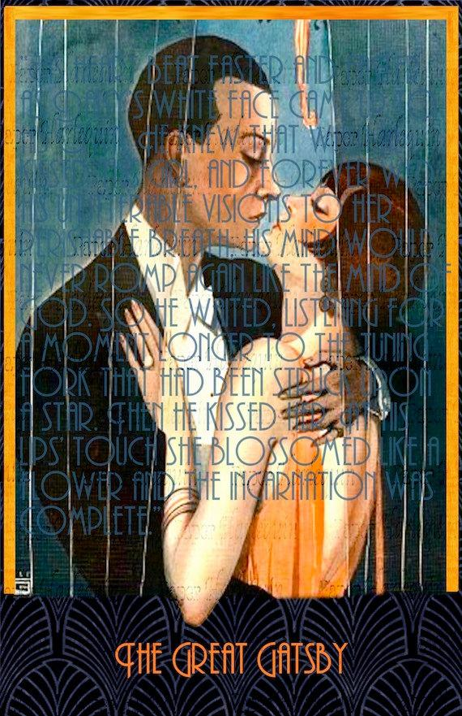
Analysis
Chapter 7 brings the conflict between Tom and Gatsby into the open, and their confrontation over Daisy brings to the surface troubling aspects of both characters. Hints have been given throughout the previous chapters about Gatsby's criminal activity. Tom becomes suspicious and exposes him to everyone for who he is because he is a fraud. His bad side of himself also had shown.

Slide 4
Tone/Mood
For Tone there is a sense of secrecy, greediness, ironic, and selfishness. Mood is portrayed in several ways such as, nostalgic, tense and judging. Most of this is because of Gatsby lashing out.

Slide 5
Theme
Class. Both Tom and Daisy are in a different class than Gatsby. Selfishness. After the argument Daisy chooses Tom over Gatsby due to her materialistic wishes and selfishness.

Slide 6
Purpose
The purpose of this chapter to show how far Gatsby was going to go to get what he wants. To be with Daisy. He went to a great extent to spend time with her. The purpose was to also reveal his true self (Great Gatsby.)

Slide 7
Symbolism
Daisy's voice
Valley of ashes
Green Light

